Slide 1
CEF 440: INTERNET PROGRAMMING (J2EE) AND MOBILE PROGRAMMING
UI DESIGN AND IMPLEMENTATION MARKET MANAGEMENT SYSTEM
Course Instructor
DR. VALERY NKEMENI

Slide 2
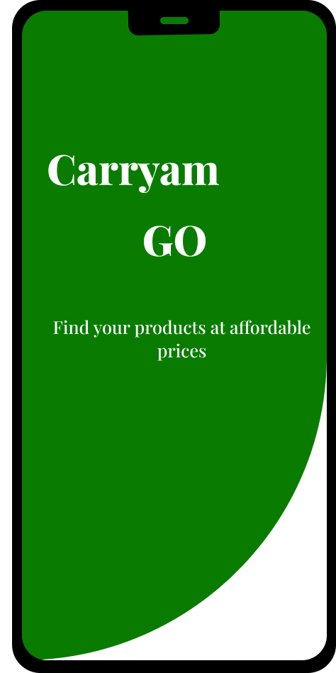
CARRYAM GO
Is here to facilitate and ensure a seamless interaction between buyers and sellers in a market setting, enabling buyers to access information about item availability, prices, and locations, while empowering sellers to showcase their products, prices, and market locations

Slide 3

Methodology
In the design and implementation of the UI/UX, we made use of the Agile methodology, which adopts an iterative and incremental development approach. It breaks down the development into smaller sprints or phases to allow for continuous improvement and responsiveness to user needs.

Slide 4

Design Pattern
we made use of the Z design pattern, which is a common approach in mobile app design that follows the natural reading and scanning patterns of users. It helps guide users' attention and optimize the presentation of important information

Slide 5

Visual Design
In the design of our UI/UX we incorporated a clean and modern aesthetic, with a focus on simplicity and clarity
Under the visual designs we will look at the following:
Color Scheme
2. Typography
3. Buttons
4. Designs

Slide 6
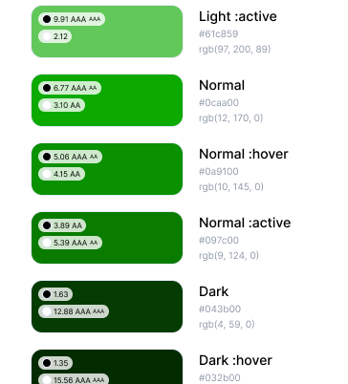
Color Scheme
We decided to make use of green which tells the nature of how most of our local markets look on market days.

Slide 7
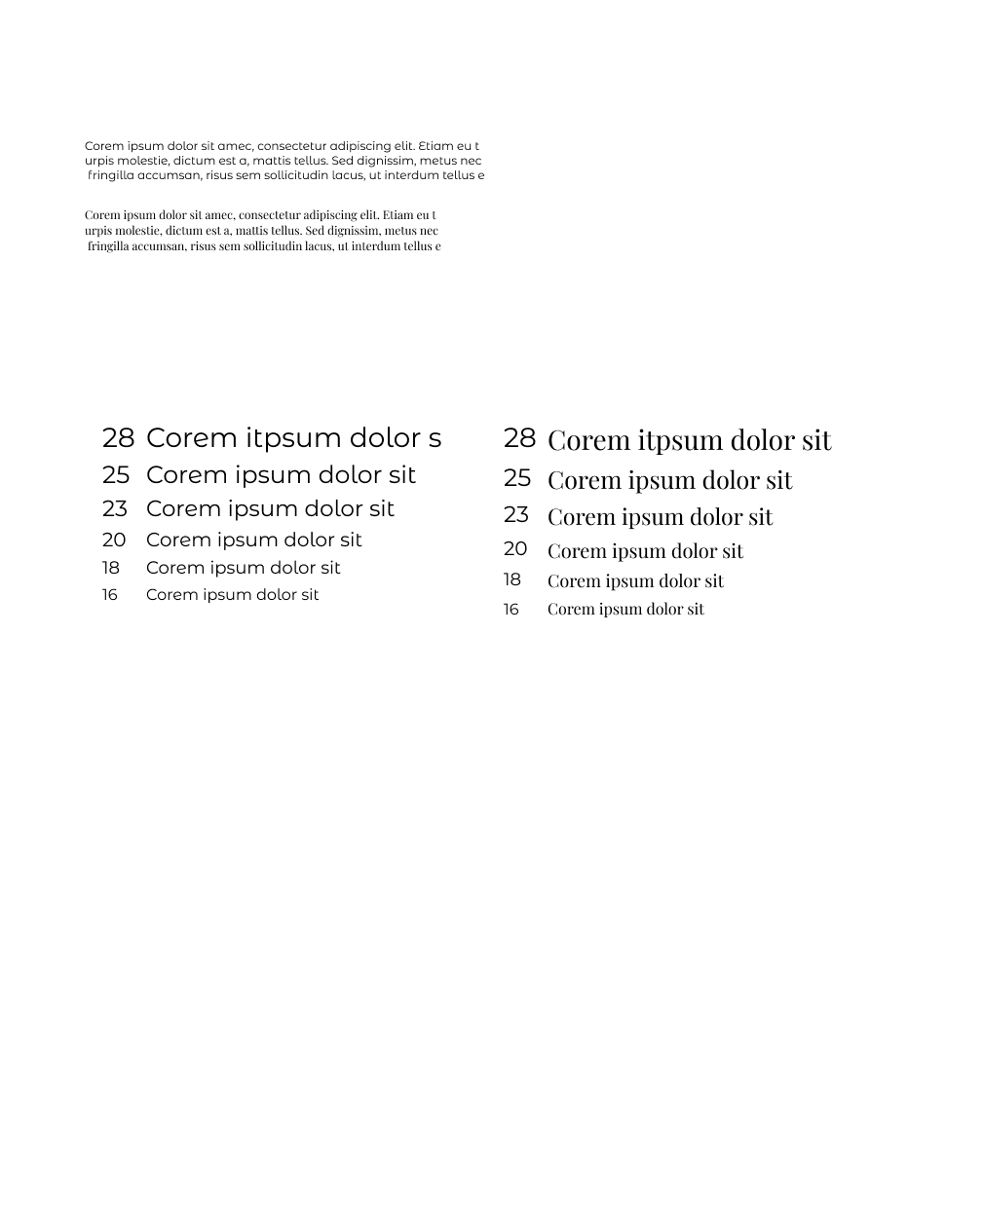
Typography
In the design and implementation of our applications UI/UX we decided to use montserrat and playfair light as our main fonts. These two fonts help us with legibility and visual hierarchy. They are also clear and easily readable fonts which are good for headings, titles, and body text, ensuring a comfortable reading experience for our users (buyers and sellers). Below is sample of our two fonts

Slide 8
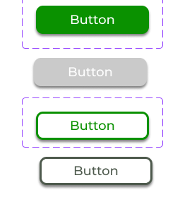
Buttons
We decided to use buttons with rounded edges because they provide an appealing view to the users when they are using our application..

Slide 9
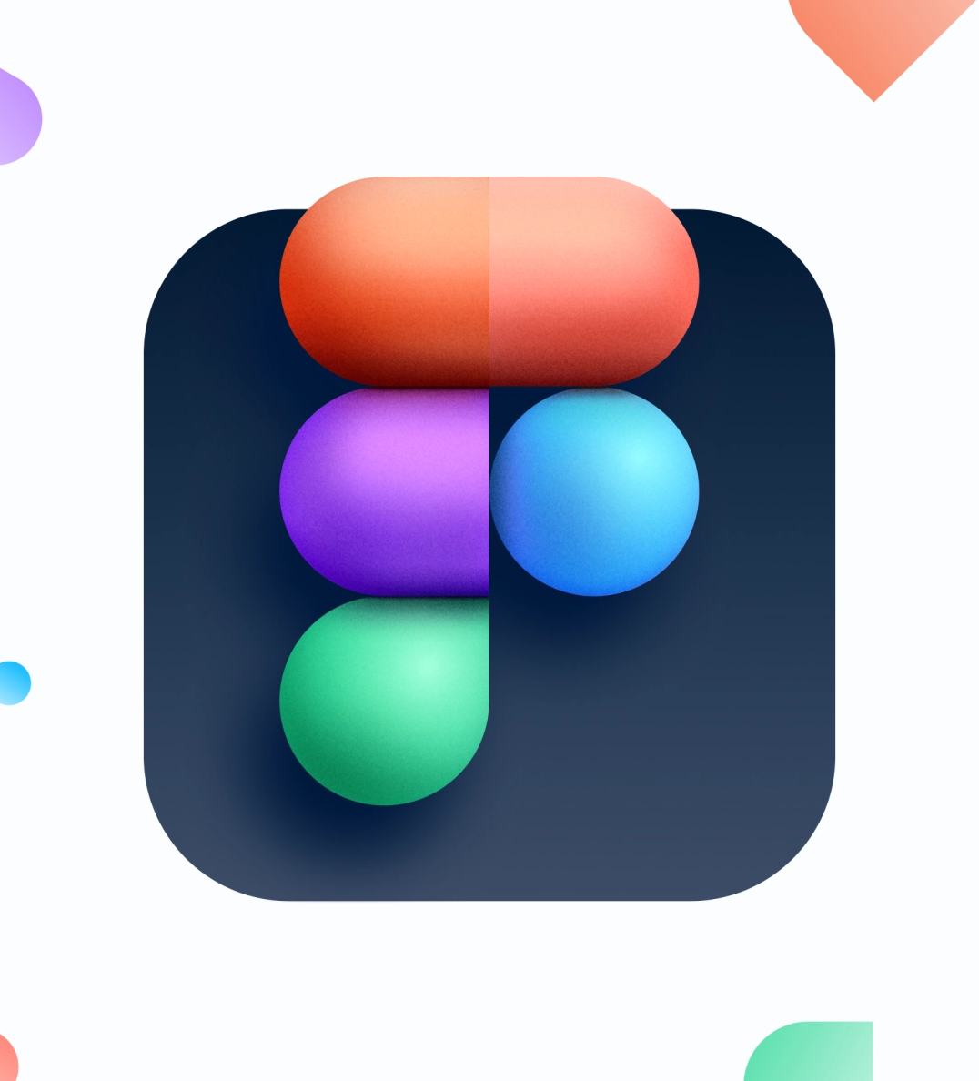
Designs
In designing the UI/UX we made use of one of the most popular design tools for designing UI/UX of applications which is figma. The reasons why we decided to

Slide 10
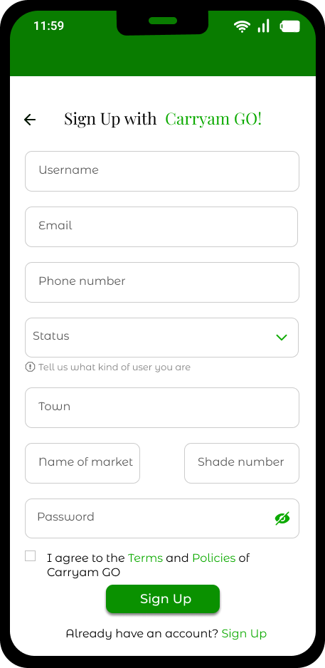
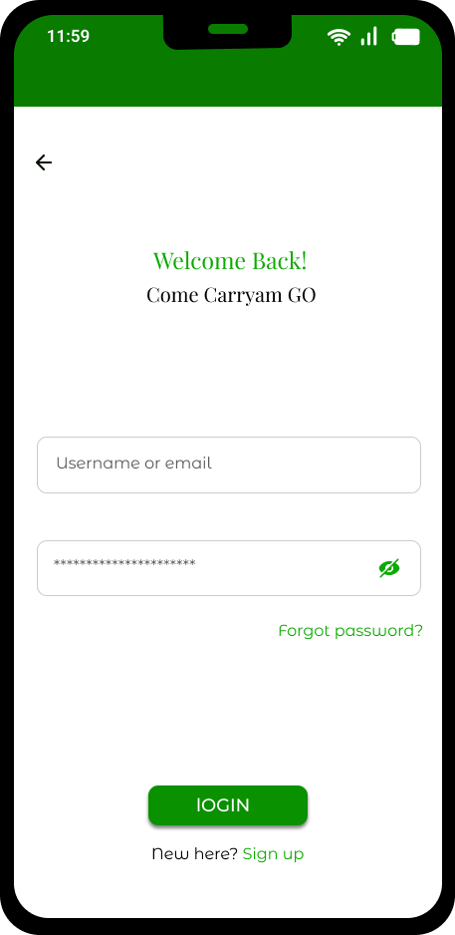
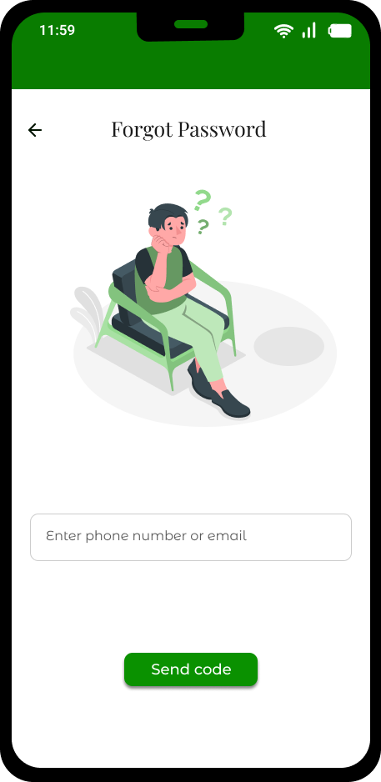

Slide 11
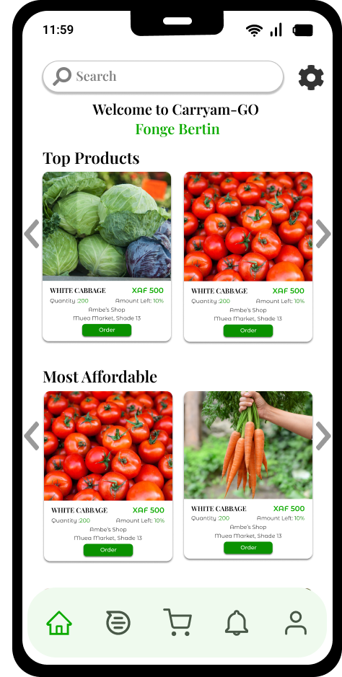
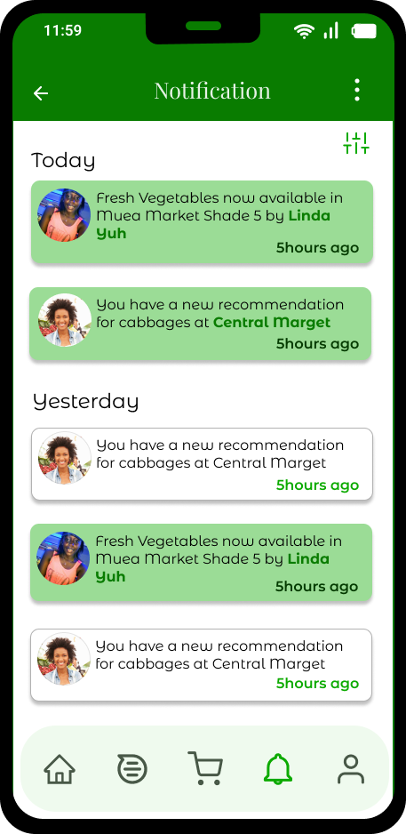
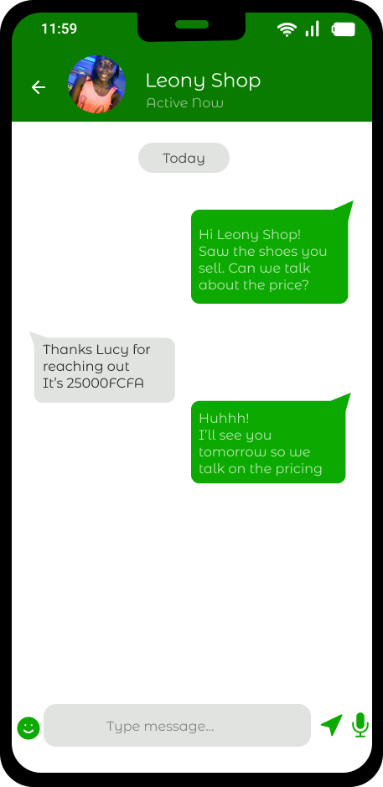

Slide 12
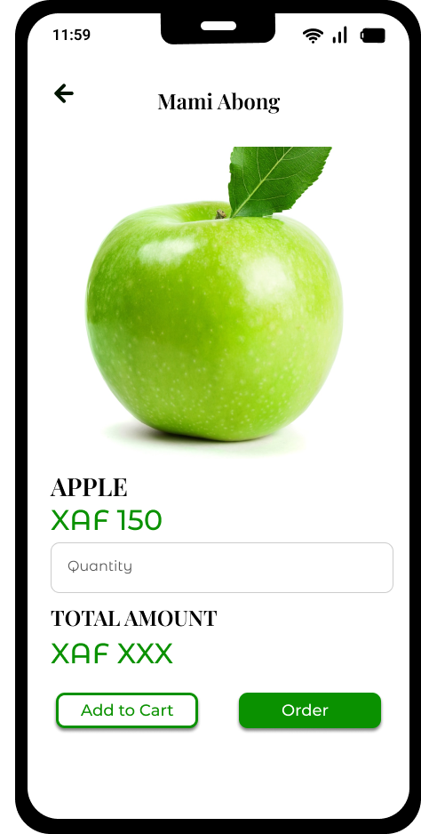
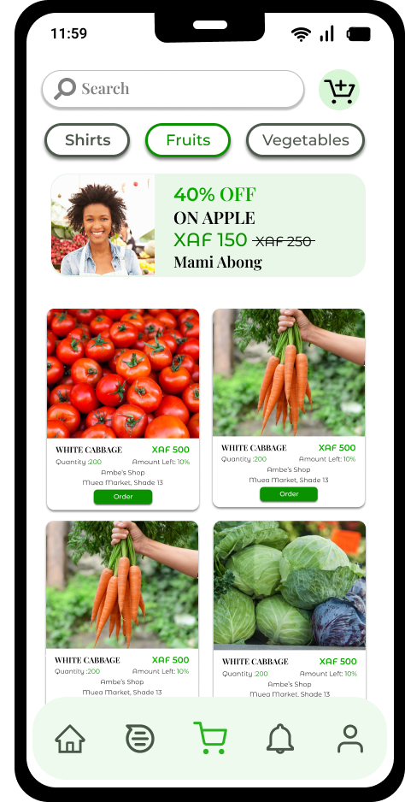
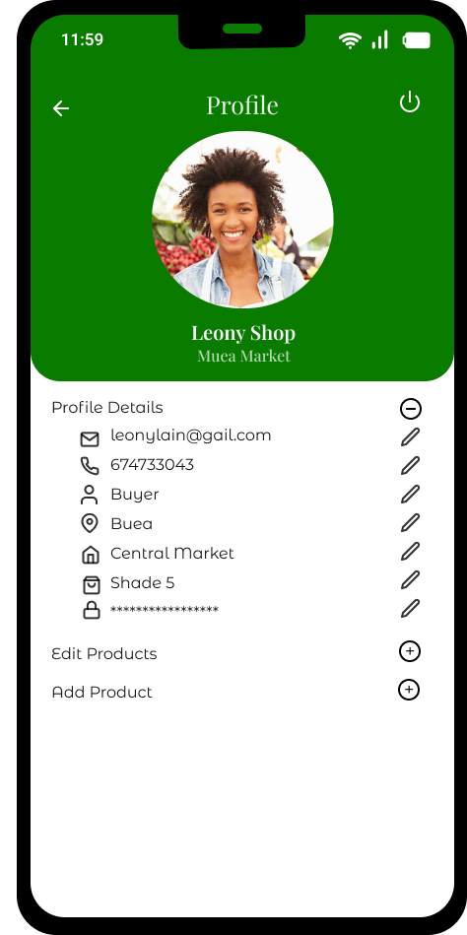

Slide 13

Frontend Implementation
The UX/UX of the project was implemented using React Native. React Native is an open source mobile application development framework created by Facebook.It uses Javascript to create cross-platform mobile applications enabling us to develop mobile apps for both iOS and Android simultaneously using a single codebase

Slide 14
Why Use ReactNative?
ReactNative was chosen due to the following reasons:
Mobile App Development: We are developing a mobile application to enable a majority of our target population (buyers and sellers) to easily access the application.
Code Reusability: It creates cross platform apps hence helping us target a large population while saving time, effort and money.
Components: React Native allows us to create different components which can be reused wherever needed making it easier to create both simple and complex designs.

Slide 15
Development Process
1. Planning and Sprint Setup
3. Continuous Integration and Testing
2. Sprint Workflow
4. Collaboration and Communication
Conducted a planning session to define project goals, scope, and user stories based on the UI/UX design
Utilized continuous integration tools to integrate code changes from different team members seamlessly
At the beginning of each sprint, hold a sprint planning meeting to discuss and select user stories to be implemented during that sprint.
Maintained close coordination with the UI/UX designers to address any design-related questions or refinements during implementation

Slide 16
User Interface Implementation
Running the Project:
The expo-cli (command line interface) is a set of tools built around ReactNative. It was used as it abstracts away from the native code and makes it simpler to start developing in react by providing us a simpler development environment as well as utility features.
To run project:
• Download project from github
• In terminal, run npm install to install the needed node modules
• Run npm start to start the project
• Download the expo app on your phone
• Scan the QR Code generated and preview the app on your phone.
Currently Developed Pages and Reusable Components

Slide 17
Reusable Components
1. Footer: This footer was created independently so it can be reused. It contains icons which when tapped on help us navigate to the various pages of the app
2. Card: This component was created to display various products available in the market

Slide 18
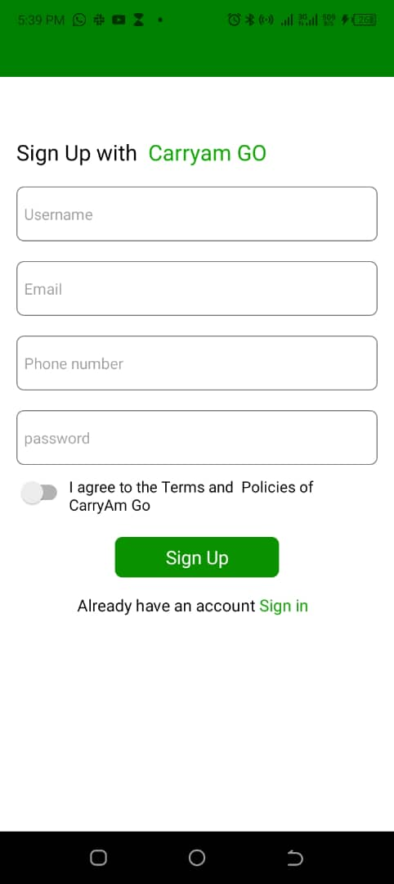
Developed Pages
1. Sign Up Page:
This page helps the buyer and seller sign in when they first visit the app.

Slide 19
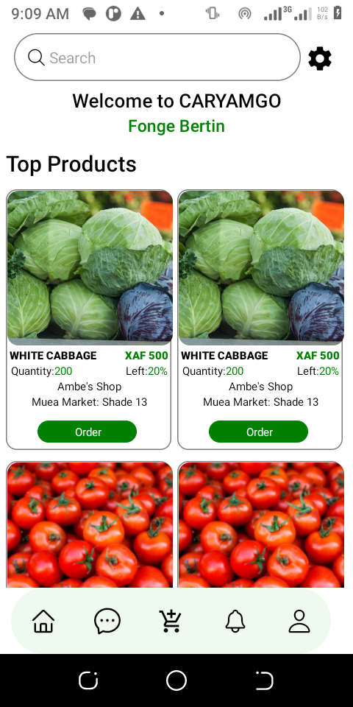
Developed Pages
2. Home Page:
This is the first page the user sees after successfully signing up..

Slide 20
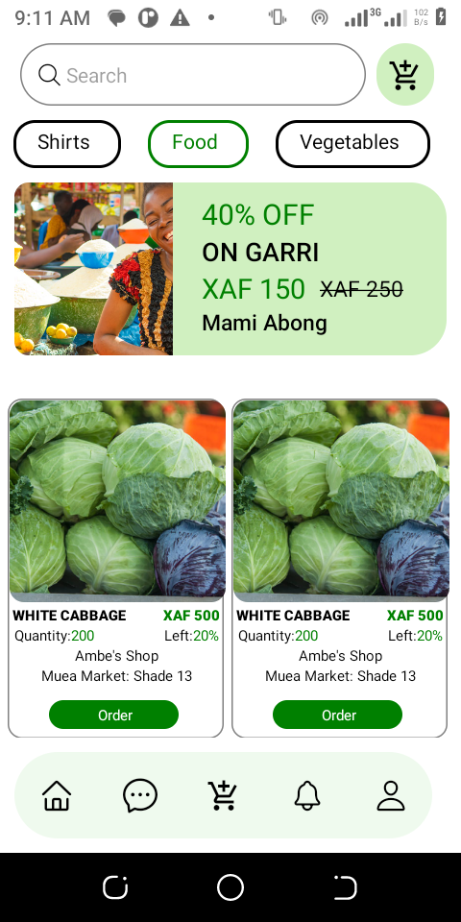
Developed Pages
3. Discount Page:
This page has helped buyers search for all foodstuffs which presently have a discount

Slide 21
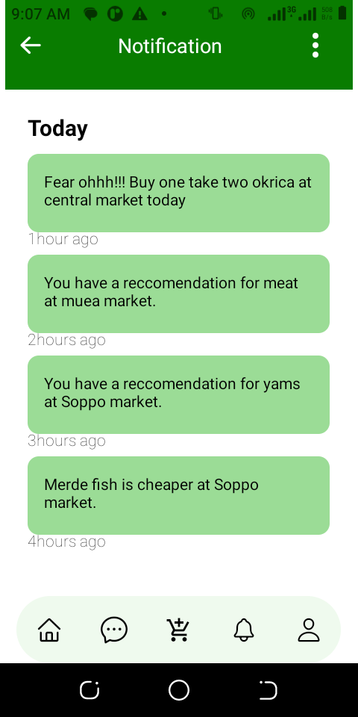

Developed Pages
4. Notification Page::
This page shows all the various notifications given to the user in recent times.

Slide 22
Components Used
React Native Components Used so Far
• TouchableOpacity: Used instead of button so it can be styled.
• View: Container view acts like a div
• Text: To display text to users
• TextInput: Enables users type in input using the default keyboard it provides
• Switch: Enables users accept or decline our policies at sign up page
• ScrollView: Used to enable scrolling on a page
• Stylesheet: Enables styling of components.

Slide 23
Testing Strategies
- Functional Testing: Verifying that all frontend features and functionalities work as intended, such as displaying product information, prices, and locations correctly.
- Usability Testing: Evaluating the user-friendliness and intuitiveness of the UI design by conducting user tests and gathering feedback.

Slide 24
UI/UX Testing:
- Responsiveness Testing: Verifying that the UI adapts and displays correctly on various devices, including smartphones and tablets, with different screen sizes and orientations.
- Usability Testing: Observing and collecting feedback from users to evaluate the ease of use, intuitiveness, and overall satisfaction with the UI/UX design.

Slide 25
Conclusion
With the implementation of an enhanced and well implemented UI/UX it gives the users i.e buyers and sellers a seamless view of our application.

